Slide 1
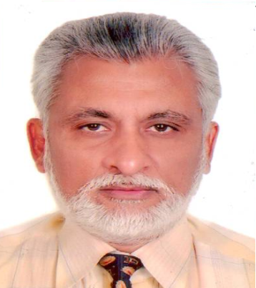
Neonatologist and clinical epidemiologist with Innovation, advocacy and strong commitment to quality, equity and accountability. Involved in system strengthening and team building & implementation research Part of many advisory and regulatory boards Delhi Medical Council (2010-15-2020), Quality Council of India (NABQP) Board Member NTBN (National Technical Board of Nutrition) NITI AYOG – till date NABH- ex Board Member representing IMA(HQ) Lead Consultant ISO/BIS NTAGI – National Technical Advisory Committee of Immunization –GOI (2001-15)EB Member & Office Bearer of CIAP -2005-07 & 2016-17 INAP (India Newborn Action Plan) IMA(Hq) - Ex Sec Academy , National Finance sec( Hq) 2014-15 NNF- chairman Quality & accreditation Administrator- www.Vaccineindia.org & www.Newbornindia.org
Dr Ajay Gambhir
M.D. (Pediatrics) & M.D. (C. Med.)
FIAP, FIAMS, FNNF
President IAP Delhi 2008-09, Vice-President CIAP 2007-08,
President, NNF (2015-16),
Secretary DMA 2020-22
NTAGI Member 2001-2017

